Slide 1


Chapter 3
Transport Layer
Computer Networking: A Top Down Approach
6th edition
Jim Kurose, Keith Ross
Addison-Wesley
March 2012
A note on the use of these ppt slides:
We’re making these slides freely available to all (faculty, students, readers). They’re in PowerPoint form so you see the animations; and can add, modify, and delete slides (including this one) and slide content to suit your needs. They obviously represent a lot of work on our part. In return for use, we only ask the following:
If you use these slides (e.g., in a class) that you mention their source (after all, we’d like people to use our book!)
If you post any slides on a www site, that you note that they are adapted from (or perhaps identical to) our slides, and note our copyright of this material.
Thanks and enjoy! JFK/KWR
All material copyright 1996-2013
J.F Kurose and K.W. Ross, All Rights Reserved
Transport Layer
3-<number>

Slide 2

















Transport services and protocols
application
transport
network
data link
physical
provides logical communication between app processes running on different hosts
transport protocols run in end systems
  send side: breaks app messages into segments, passes to network layer
  rcv side: reassembles segments into messages, passes to app layer
more than one transport protocol available to apps
  Internet: TCP and UDP
logical end-end transport
application
transport
network
data link
physical
Transport Layer
3-<number>

Slide 3
Transport vs. network layer
household analogy:
12 kids in Ann’s house sending letters to 12 kids in Bill’s house:
hosts = houses
processes = kids
app messages = letters in envelopes
transport protocol = Ann and Bill who gives letters to in-house siblings
network-layer protocol = postal service
Transport Layer
3-<number>

Slide 4
Internet transport-layer protocols
reliable, in-order delivery (TCP)
  congestion control
  flow control
  connection setup
unreliable, unordered delivery: UDP
  no-frills extension of “best-effort” IP
services not available:
  delay guarantees
  bandwidth guarantees
application
transport
network
data link
physical
network
data link
physical
network
data link
physical
network
data link
physical
logical end-end transport
network
data link
physical
network
data link
physical
network
data link
physical
network
data link
physical
application
transport
network
data link
physical
Transport Layer
3-<number>

Slide 5
Chapter 3 outline
3.1 transport-layer services
3.2 multiplexing and demultiplexing
3.3 connectionless transport: UDP
3.4 principles of reliable data transfer
3.5 connection-oriented transport: TCP
  segment structure
  reliable data transfer
  flow control
  connection management
3.6 principles of congestion control
3.7 TCP congestion control
Transport Layer
3-<number>

Slide 6

Multiplexing/demultiplexing
multiplexing at sender:
demultiplexing at receiver:
Gathering data from multiple sockets and passing the segment to the network layer.
use header info to deliver
received segments to correct
process
application
application
P1
P2
application
socket
P3
transport
P4
process
transport
network
transport
network
link
network
link
physical
link
physical
physical
Transport Layer
3-<number>

Slide 7
How demultiplexing works
host receives IP datagrams
  each datagram has source IP address, destination IP address
  each segment has 16-bit source, destination port number
host uses IP addresses & port numbers to direct segment to appropriate socket
32 bits
source port #
dest port #
other header fields
application
data
(payload)
TCP/UDP segment format
Transport Layer
3-<number>

Slide 8
Connectionless MUX- DEMUX
when creating datagram to send into UDP socket, must specify
  destination IP address
  destination port #
when host receives UDP segment:
  checks destination port # in segment
  directs UDP segment to socket with that port #
IP datagrams with same dest. port #, but different source IP addresses and/or source port numbers will be directed to same socket at destination
Transport Layer
3-<number>

Slide 9
Connectionless demux: example
p1 port : 6428
p3 port : 9157
p4 port: 1288
application
application
P1
application
P3
P4
transport
transport
network
transport
network
link
network
link
physical
link
physical
physical
source port: 6428
dest port: 9157
source port: ?
dest port: ?
source port: 9157
dest port: 6428
source port: ?
dest port: ?
Transport Layer
3-<number>

Slide 10
Connection-oriented demux
TCP socket identified by 4-tuple:
  source IP address
  source port number
  dest IP address
  dest port number
demux: receiver uses all four values to direct segment to appropriate socket
server host may support many simultaneous TCP connections:
  each socket identified by its own 4-tuple
TCP web servers have different sockets for each connecting client.
Transport Layer
3-<number>

Slide 11
Connection-oriented demux: example
P1 port: 9157
P4 port: 80
P2 port: 5775
P3 port : 9158
application
application
P4
P5
P6
application
P1
P2
P3
transport
transport
network
transport
network
link
network
link
physical
link
physical
server: IP address B
physical
host: IP addr A
source IP,port: B,80
dest IP,port: A,9157
host: IP addr C
source IP,port: C,5775
dest IP,port: B,80
source IP,port: A,9157
dest IP, port: B,80
source IP,port: C,9158
dest IP,port: B,80
three segments, all destined to IP address: B,
dest port: 80 are demultiplexed to different sockets
Transport Layer
3-<number>

Slide 12
Connection-oriented demux: example
threaded server
application
application
application
P4
P3
P3
P2
transport
transport
network
transport
network
link
network
link
physical
link
physical
server: IP address B
physical
host: IP address A
source IP,port: B,80
dest IP,port: A,9157
host: IP address C
source IP,port: C,5775
dest IP,port: B,80
source IP,port: A,9157
dest IP, port: B,80
source IP,port: C,9157
dest IP,port: B,80
Transport Layer
3-<number>

Slide 13
Chapter 3 outline
3.1 transport-layer services
3.2 multiplexing and demultiplexing
3.3 connectionless transport: UDP
3.4 principles of reliable data transfer
3.5 connection-oriented transport: TCP
  segment structure
  reliable data transfer
  flow control
  connection management
3.6 principles of congestion control
3.7 TCP congestion control
Transport Layer
3-<number>

Slide 14
UDP: User Datagram Protocol [RFC 768]
“no frills,” “bare bones” Internet transport protocol
“best effort” service, UDP segments may be:
  lost
  delivered out-of-order to app
connectionless:
  no handshaking between UDP sender, receiver
  each UDP segment handled independently of others
UDP use:
  streaming multimedia apps (loss tolerant, rate sensitive)
  DNS
  SNMP
reliable transfer over UDP:
  add reliability at application layer
  application-specific error recovery!
Transport Layer
3-<number>

Slide 15
UDP: segment header
length, in bytes of UDP segment, including header
32 bits
source port #
dest port #
length
checksum
why is there a UDP?
no connection establishment (which can add delay)
simple: no connection state at sender, receiver
small header size
no congestion control: UDP can blast away as fast as desired
application
data
(payload)
UDP segment format
Transport Layer
3-<number>

Slide 16
UDP checksum
Goal: detect “errors” (e.g., flipped bits) in transmitted segment
sender:
Divide segment contents, including header fields, as sequence of 16-bit integers
checksum: addition (one’s complement sum) of segment contents
sender puts checksum value into UDP checksum field
receiver:
compute checksum of received segment
check if computed checksum equals checksum field value:
  NO - error detected
  YES - no error detected. ….
Transport Layer
3-<number>

Slide 17
Internet checksum: example
example: add two 16-bit integers
1 1 1 1 0 0 1 1 0 0 1 1 0 0 1 1 0
1 1 1 0 1 0 1 0 1 0 1 0 1 0 1 0 1
1 1 0 1 1 1 0 1 1 1 0 1 1 1 0 1 1
1 1 0 1 1 1 0 1 1 1 0 1 1 1 1 0 0
1 0 1 0 0 0 1 0 0 0 1 0 0 0 0 1 1
wraparound
sum
1’s complement
checksum
Note: when adding numbers, a carryout from the most significant bit needs to be added to the result
Transport Layer
3-<number>
Notes:
Kurose and Ross forgot to say anything about wrapping the carry and adding it to low order bit

Slide 18
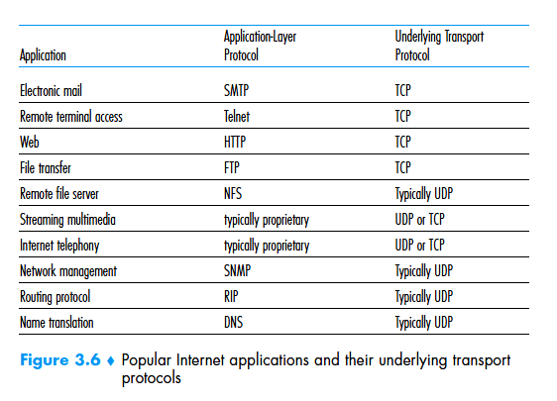

Transport Layer
3-<number>

Slide 19
Chapter 3 outline
3.1 transport-layer services
3.2 multiplexing and demultiplexing
3.3 connectionless transport: UDP
3.4 principles of reliable data transfer
3.5 connection-oriented transport: TCP
  segment structure
  reliable data transfer
  flow control
  connection management
3.6 principles of congestion control
3.7 TCP congestion control
Transport Layer
3-<number>

Slide 20
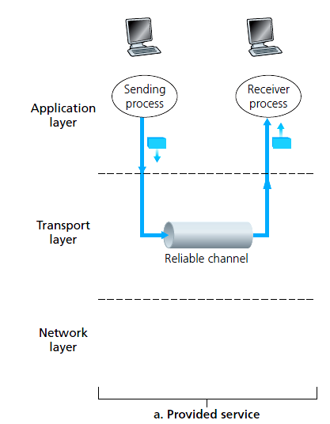
Principles of reliable data transfer
important in application, transport, link layers
  One of the top-10 list of important networking topics!
complexity of reliable data transfer protocol (rdt) depends on unreliable channel
Transport Layer
3-<number>

Slide 21
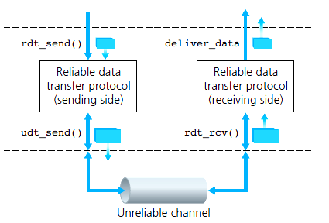
Reliable data transfer: getting started
rdt_send(): called from app. To pass data to be delivered to receiver upper layer
deliver_data(): called by rdt to deliver data to upper
Send
side
receive
side
udt_send(): called by rdt,
to transfer packet over
unreliable channel to receiver
rdt_rcv(): called when packet arrives on rcv-side of channel
Transport Layer
3-<number>

Slide 22
Reliable data transfer: getting started
we’ll :
incrementally develop sender, receiver sides of reliable data transfer protocol (rdt)
consider only unidirectional data transfer
  but control info will flow on both directions!
use finite state machines (FSM) to specify sender, receiver
event causing state transition
actions taken on state transition
state: when in this “state” next state uniquely determined by next event
state
1
state
2
event
actions
Transport Layer
3-<number>

Slide 23
rdt1.0: reliable transfer over a reliable channel
underlying channel perfectly reliable
  no bit errors
  no loss of packets
separate FSMs for sender, receiver:
  sender sends data into underlying channel
  receiver reads data from underlying channel
Wait for call from above
rdt_send(data)
Wait for call from below
rdt_rcv(packet)
extract (packet,data)
deliver_data(data)
packet = make_pkt(data)
udt_send(packet)
sender
receiver
Transport Layer
3-<number>

Slide 24
rdt2.0: channel with bit errors
underlying channel may flip bits in packet
  checksum to detect bit errors
the question: how to recover from errors:
  acknowledgements (ACKs): receiver explicitly tells sender that pkt received OK
  negative acknowledgements (NAKs): receiver explicitly tells sender that pkt had errors
  sender retransmits pkt on receipt of NAK
new mechanisms in rdt2.0 (beyond rdt1.0):
  error detection
  receiver feedback: control msgs (ACK,NAK) rcvr->sender
How do humans recover from “errors”
during conversation?
Transport Layer
3-<number>

Slide 25
rdt2.0: channel with bit errors
the question: how to recover from errors:
  acknowledgements (ACKs): receiver explicitly tells sender that pkt received OK
  negative acknowledgements (NAKs): receiver explicitly tells sender that pkt had errors
  sender retransmits pkt on receipt of NAK – Automatic Repeat Request (ARQ) protocols.
New mechanisms in rdt2.0 (beyond rdt1.0):
  error detection : checksum
  Receiver feedback: control msgs (ACK,NAK) from receiver to sender
  Retransmission
Transport Layer
3-<number>

Slide 26
rdt2.0: FSM specification
rdt_send(data)
sndpkt = make_pkt(data, checksum)
udt_send(sndpkt)
receiver
rdt_rcv(rcvpkt) &&
isNAK(rcvpkt)
Wait for call from above
Wait for ACK or NAK
rdt_rcv(rcvpkt) &&
corrupt(rcvpkt)
udt_send(sndpkt)
udt_send(NAK)
rdt_rcv(rcvpkt) && isACK(rcvpkt)
Λ
Wait for call from below
sender
rdt_rcv(rcvpkt) &&
notcorrupt(rcvpkt)
extract(rcvpkt,data)
deliver_data(data)
udt_send(ACK)
Transport Layer
3-<number>

Slide 27
rdt2.0: operation with no errors
rdt_send(data)
snkpkt = make_pkt(data, checksum)
udt_send(sndpkt)
rdt_rcv(rcvpkt) &&
isNAK(rcvpkt)
Wait for call from above
Wait for ACK or NAK
rdt_rcv(rcvpkt) &&
corrupt(rcvpkt)
udt_send(sndpkt)
udt_send(NAK)
rdt_rcv(rcvpkt) && isACK(rcvpkt)
Wait for call from below
Λ
rdt_rcv(rcvpkt) &&
notcorrupt(rcvpkt)
extract(rcvpkt,data)
deliver_data(data)
udt_send(ACK)
Transport Layer
3-<number>

Slide 28
rdt2.0: error scenario
rdt_send(data)
snkpkt = make_pkt(data, checksum)
udt_send(sndpkt)
rdt_rcv(rcvpkt) &&
isNAK(rcvpkt)
Wait for call from above
Wait for ACK or NAK
rdt_rcv(rcvpkt) &&
corrupt(rcvpkt)
udt_send(sndpkt)
udt_send(NAK)
rdt_rcv(rcvpkt) && isACK(rcvpkt)
Wait for call from below
Λ
rdt_rcv(rcvpkt) &&
notcorrupt(rcvpkt)
extract(rcvpkt,data)
deliver_data(data)
udt_send(ACK)
Transport Layer
3-<number>

Slide 29
rdt2.0 has a fatal flaw!
what happens if ACK/NAK corrupted?
sender doesn’t know what happened at receiver!
Possibilities :
Include new type of packet to the protocol
Add checksum bits to not only detect but also correct the errors.
Just retransmit in case of corrupted ACK/NAK : Duplicate Packets !
handling duplicates:
sender adds 1-bit sequence number to each pkt
receiver discards (doesn’t deliver up) duplicate pkt.
stop and wait
sender sends one packet,
then waits for receiver
Response
Alternating Bit protocol
Transport Layer
3-<number>

Slide 30
rdt2.1: sender, handles garbled ACK/NAKs
rdt_send(data)
sndpkt = make_pkt(0, data, checksum)
udt_send(sndpkt)
rdt_rcv(rcvpkt) &&
( corrupt(rcvpkt) ||
isNAK(rcvpkt) )
Wait for call 0 from above
Wait for ACK or NAK 0
udt_send(sndpkt)
rdt_rcv(rcvpkt)
&& notcorrupt(rcvpkt)
&& isACK(rcvpkt)
rdt_rcv(rcvpkt)
&& notcorrupt(rcvpkt)
&& isACK(rcvpkt)
Λ
Λ
Wait for ACK or NAK 1
Wait for
call 1 from above
rdt_rcv(rcvpkt) &&
( corrupt(rcvpkt) ||
isNAK(rcvpkt) )
rdt_send(data)
udt_send(sndpkt)
sndpkt = make_pkt(1, data, checksum)
udt_send(sndpkt)
Transport Layer
3-<number>

Slide 31
rdt2.1: receiver, handles garbled ACK/NAKs
rdt_rcv(rcvpkt) && notcorrupt(rcvpkt)
&& has_seq0(rcvpkt)
extract(rcvpkt,data)
deliver_data(data)
sndpkt = make_pkt(ACK, chksum)
udt_send(sndpkt)
rdt_rcv(rcvpkt) && (corrupt(rcvpkt)
rdt_rcv(rcvpkt) && (corrupt(rcvpkt)
sndpkt = make_pkt(NAK, chksum)
udt_send(sndpkt)
sndpkt = make_pkt(NAK, chksum)
udt_send(sndpkt)
Wait for
0 from below
Wait for
1 from below
rdt_rcv(rcvpkt) &&
not corrupt(rcvpkt) &&
has_seq1(rcvpkt)
rdt_rcv(rcvpkt) &&
not corrupt(rcvpkt) &&
has_seq0(rcvpkt)
sndpkt = make_pkt(ACK, chksum)
udt_send(sndpkt)
sndpkt = make_pkt(ACK, chksum)
udt_send(sndpkt)
rdt_rcv(rcvpkt) && notcorrupt(rcvpkt)
&& has_seq1(rcvpkt)
extract(rcvpkt,data)
deliver_data(data)
sndpkt = make_pkt(ACK, chksum)
udt_send(sndpkt)
Transport Layer
3-<number>

Slide 32
rdt2.1: discussion
sender:
seq # added to pkt
two seq. #’s (0,1) will suffice. Why?
must check if received ACK/NAK corrupted
twice as many states
  state must “remember” whether “expected” pkt should have seq # of 0 or 1
receiver:
must check if received packet is duplicate
  state indicates whether 0 or 1 is expected pkt seq #
note: receiver can not know if its last ACK/NAK received OK at sender
Transport Layer
3-<number>

Slide 33
rdt2.2: a NAK-free protocol
Same functionality as rdt2.1, using ACKs only
instead of NAK, receiver sends ACK for last pkt received OK
  receiver includes seq# of last packet being ACKed
duplicate ACK at sender results in same action as NAK: retransmit current packet
Transport Layer
3-<number>

Slide 34
rdt2.2: sender (without NAK)
rdt_send(data)
sndpkt = make_pkt(0, data, checksum)
udt_send(sndpkt)
rdt_rcv(rcvpkt) &&
( corrupt(rcvpkt) ||
isACK(rcvpkt,1) )
Wait for call 0 from above
Wait for ACK or NAK 0
udt_send(sndpkt)
rdt_rcv(rcvpkt)
&& notcorrupt(rcvpkt)
&& isACK(rcvpkt,1)
rdt_rcv(rcvpkt)
&& notcorrupt(rcvpkt)
&& isACK(rcvpkt,0)
Λ
Λ
Wait for ACK or NAK 1
Wait for
call 1 from above
rdt_rcv(rcvpkt) &&
( corrupt(rcvpkt) ||
isACK(rcvpkt,0) )
rdt_send(data)
udt_send(sndpkt)
sndpkt = make_pkt(1, data, checksum)
udt_send(sndpkt)
Transport Layer
3-<number>

Slide 35
rdt2.2: receiver, handles garbled ACK
rdt_rcv(rcvpkt) && notcorrupt(rcvpkt)
&& has_seq0(rcvpkt)
extract(rcvpkt,data)
deliver_data(data)
sndpkt = make_pkt(ACK, 0,chksum)
udt_send(sndpkt)
rdt_rcv(rcvpkt) &&
(corrupt(rcvpkt) ||
has_seq0(rcvpkt))
Wait for
0 from below
Wait for
1 from below
rdt_rcv(rcvpkt) &&
(corrupt(rcvpkt) ||
has_seq1(rcvpkt))
sndpkt = make_pkt(ACK, 0,chksum)
udt_send(sndpkt)
sndpkt = make_pkt(ACK,1 chksum)
udt_send(sndpkt)
rdt_rcv(rcvpkt) && notcorrupt(rcvpkt)
&& has_seq1(rcvpkt)
extract(rcvpkt,data)
deliver_data(data)
sndpkt = make_pkt(ACK, 1,chksum)
udt_send(sndpkt)
Transport Layer
3-<number>

Slide 36
rdt3.0: channels with errors and loss
new assumption: underlying channel can also lose packets (data, ACKs)
  checksum, seq. #, ACKs, retransmissions will be of help … but not enough!!!!
approach:
sender waits “reasonable” amount of time for ACK
Set up Timer !!
if pkt or ACK just delayed (not lost):
  Assume packet is lost and retransmit the packet.
  retransmission may be duplicate, but seq. # handles this.
Transport Layer
3-<number>

Slide 37
rdt3.0 sender
rdt_send(data)
rdt_rcv(rcvpkt) &&
( corrupt(rcvpkt) ||
isACK(rcvpkt,1) )
sndpkt = make_pkt(0, data, checksum)
udt_send(sndpkt)
start_timer
rdt_rcv(rcvpkt)
Λ
Λ
Wait for
call 0from above
Wait for ACK0
timeout
udt_send(sndpkt)
start_timer
rdt_rcv(rcvpkt)
&& notcorrupt(rcvpkt)
&& isACK(rcvpkt,1)
rdt_rcv(rcvpkt)
&& notcorrupt(rcvpkt)
&& isACK(rcvpkt,0)
stop_timer
stop_timer
Wait for ACK1
Wait for
call 1 from above
timeout
udt_send(sndpkt)
start_timer
rdt_rcv(rcvpkt)
rdt_send(data)
Λ
rdt_rcv(rcvpkt) &&
( corrupt(rcvpkt) ||
isACK(rcvpkt,0) )
sndpkt = make_pkt(1, data, checksum)
udt_send(sndpkt)
start_timer
Λ
rdt3.0 Receiver is same as rdt 2.2
Transport Layer
3-<number>

Slide 38

rdt3.0 in action
sender
receiver
sender
receiver
send pkt0
pkt0
send pkt0
pkt0
rcv pkt0
rcv pkt0
ack0
send ack0
ack0
send ack0
rcv ack0
rcv ack0
send pkt1
pkt1
send pkt1
pkt1
rcv pkt1
X
ack1
send ack1
loss
rcv ack1
send pkt0
pkt0
rcv pkt0
timeout
resend pkt1
ack0
send ack0
pkt1
rcv pkt1
ack1
send ack1
rcv ack1
send pkt0
pkt0
(a) no loss
rcv pkt0
ack0
send ack0
(b) packet loss
Transport Layer
3-<number>

Slide 39
rdt3.0 in action
sender
receiver
sender
receiver
send pkt0
pkt0
send pkt0
pkt0
rcv pkt0
rcv pkt0
ack0
send ack0
send ack0
rcv ack0
ack0
send pkt1
pkt1
rcv ack0
rcv pkt1
send pkt1
pkt1
send ack1
rcv pkt1
ack1
send ack1
ack1
X
loss
timeout
resend pkt1
pkt1
rcv pkt1
timeout
resend pkt1
rcv ack1
pkt1
rcv pkt1
pkt0
(detect duplicate)
send pkt0
send ack1
ack1
(detect duplicate)
ack1
rcv pkt0
rcv ack1
send ack1
rcv ack1
ack0
send ack0
pkt0
send pkt0
pkt0
send pkt0
rcv pkt0
rcv pkt0
ack0
(detect duplicate)
ack0
send ack0
send ack0
(c) ACK loss
(d) premature timeout/ delayed ACK
Transport Layer
3-<number>

Slide 40
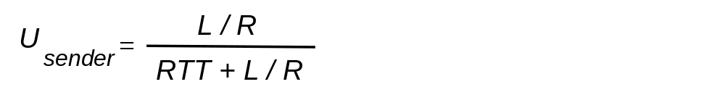
rdt3.0: stop-and-wait operation
sender
receiver
first packet bit transmitted, t = 0
last packet bit transmitted, t = L / R
first packet bit arrives
RTT
last packet bit arrives, send ACK
ACK arrives, send next
packet, t = RTT + L / R
Transport Layer
3-<number>

Slide 41

Performance of rdt3.0
rdt3.0 is correct, but performance stinks
e.g.: 1 Gbps link, 15 ms prop. delay, 8000 bit packet:
L
8000 bits
D_{trans} =
=
=
8 microsecs
R
10⁹ bits/sec
  U _{sender}: utilization – fraction of time sender busy sending
  if RTT=30 msec,
network protocol limits use of physical resources!
Transport Layer
3-<number>

Slide 42


Pipelined protocols
pipelining: sender allows multiple packets without waiting for ACK.
  range of sequence numbers must be increased
  buffering at sender and/or receiver
two generic forms of pipelined protocols: go-Back-N, selective repeat
Transport Layer
3-<number>

Slide 43

Pipelining: increased utilization
sender
receiver
first packet bit transmitted, t = 0
last bit transmitted, t = L / R
first packet bit arrives
RTT
last packet bit arrives, send ACK
last bit of 2nd packet arrives, send ACK
last bit of 3rd packet arrives, send ACK
ACK arrives, send next
packet, t = RTT + L / R
3-packet pipelining increases
utilization by a factor of 3!!!
Transport Layer
3-<number>

Slide 44
Pipelined protocols: overview
Go-back-N:
sender can have up to N unacked packets in pipeline
receiver only sends cumulative ack
  doesn’t ack packet if there’s a gap
sender has timer for oldest unacked packet
  when timer expires, retransmit all unacked packets
Selective Repeat:
sender can have up to N unack’ed packets in pipeline
rcvr sends individual ack for each packet
sender maintains timer for each unacked packet
  when timer expires, retransmit only that unacked packet
Transport Layer
3-<number>

Slide 45

Go-Back-N(Sliding window ) sender
k-bit seq. number in packet header
“window” of up to N, consecutive unacknowledged packets allowed
ACK(n): Acknowledges all packets up to received n - “cumulative ACK”
  may receive duplicate ACKs (see receiver)
timer for oldest unacknowledged packets
timeout(n): retransmit packet n and all higher seq. number packets in window
Transport Layer
3-<number>

Slide 46
GBN: sender extended FSM
Events at sender:
Invocation from above.
Receipt of an ACK.
Timeout.
rdt_send(data)
if (nextseqnum < base+N) {
sndpkt[nextseqnum] = make_pkt(nextseqnum,data,chksum)
udt_send(sndpkt[nextseqnum])
if (base == nextseqnum)
start_timer
nextseqnum++
}
else
refuse_data(data)
Λ
base=0
nextseqnum=0
timeout
Wait
start_timer
udt_send(sndpkt[base])
udt_send(sndpkt[base+1])
…
udt_send(sndpkt[nextseqnum-1])
rdt_rcv(rcvpkt)
&& corrupt(rcvpkt)
Λ
rdt_rcv(rcvpkt) &&
notcorrupt(rcvpkt)
base = getacknum(rcvpkt)+1
If (base == nextseqnum)
stop_timer
else
start_timer
Transport Layer
3-<number>

Slide 47
GBN: receiver extended FSM
default
udt_send(sndpkt)
rdt_rcv(rcvpkt)
&& notcurrupt(rcvpkt)
&& hasseqnum(rcvpkt,expectedseqnum)
Λ
Wait
extract(rcvpkt,data)
deliver_data(data)
sndpkt = make_pkt(expectedseqnum,ACK,chksum)
udt_send(sndpkt)
expectedseqnum++
expectedseqnum=0
sndpkt =
make_pkt(expectedseqnum,ACK,chksum)
ACK-only: always send ACK for correctly-received pkt with highest in-order seq. no.
  may generate duplicate ACKs
  need only remember expectedseqnum
out-of-order pkt:
  discard (don’t buffer): no receiver buffering!
  re-ACK pkt with highest in-order seq number
Transport Layer
3-<number>

Slide 48
GBN in action
sender window (N=4)
sender
receiver
0 1 2 3 4 5 6 7 8
send pkt0
send pkt1
send pkt2
send pkt3
(wait)
0 1 2 3 4 5 6 7 8
receive pkt0, send ack0
receive pkt1, send ack1
receive pkt3, discard,
(re)send ack1
0 1 2 3 4 5 6 7 8
X
0 1 2 3 4 5 6 7 8
loss
0 1 2 3 4 5 6 7 8
rcv ack0, send pkt4
rcv ack1, send pkt5
0 1 2 3 4 5 6 7 8
receive pkt4, discard,
(re)send ack1
ignore duplicate ACK
receive pkt5, discard,
(re)send ack1
pkt 2 timeout
0 1 2 3 4 5 6 7 8
send pkt2
send pkt3
send pkt4
send pkt5
0 1 2 3 4 5 6 7 8
0 1 2 3 4 5 6 7 8
rcv pkt2, deliver, send ack2
rcv pkt3, deliver, send ack3
rcv pkt4, deliver, send ack4
rcv pkt5, deliver, send ack5
0 1 2 3 4 5 6 7 8
Transport Layer
3-<number>

Slide 49
Selective repeat
receiver individually acknowledges all correctly received pkts
  buffers pkts as needed, for eventual in-order delivery to upper layer
sender only resends pkts for which ACK not received
  sender timer for each unACKed pkt
sender window
  N consecutive seq #’s
Transport Layer
3-<number>

Slide 50

Selective repeat: sender, receiver windows
Transport Layer
3-<number>

Slide 51
Selective repeat
sender
receiver
data from above:
if next available seq # in window, send pkt
timeout(n):
resend pkt n, restart timer
ACK(n) in [sendbase,sendbase+N]:
mark pkt n as received
if n smallest unACKed pkt, advance window base to next unACKed seq #
pkt n in [rcvbase, rcvbase+N-1]
send ACK(n)
out-of-order: buffer
in-order: deliver (also deliver buffered, in-order pkts), advance window to next not-yet-received pkt
pkt n in [rcvbase-N,rcvbase-1]
ACK(n)
otherwise:
ignore
Transport Layer
3-<number>

Slide 52
GBN in action
sender window (N=4)
sender
receiver
0 1 2 3 4 5 6 7 8
send pkt0
send pkt1
send pkt2
send pkt3
(wait)
0 1 2 3 4 5 6 7 8
receive pkt0, send ack0
receive pkt1, send ack1
receive pkt3, buffer,
send ack3
0 1 2 3 4 5 6 7 8
X
0 1 2 3 4 5 6 7 8
loss
0 1 2 3 4 5 6 7 8
rcv ack0, send pkt4
rcv ack1, send pkt5
0 1 2 3 4 5 6 7 8
receive pkt4, buffer,
send ack4
ACK3 arrived
receive pkt5, buffer,
send ack5
pkt 2 timeout
0 1 2 3 4 5 6 7 8
send pkt2
0 1 2 3 4 5 6 7 8
record ack4 arrived
0 1 2 3 4 5 6 7 8
rcv pkt2, deliver pkt2,pkt3,
pkt4,pkt5
send ack2
0 1 2 3 4 5 6 7 8
record ack5 arrived
Q: what happens when ack2 arrives?
Transport Layer
3-<number>

Slide 53

Selective repeat: dilemma
sender window
(after receipt)
receiver window
(after receipt)
0 1 2 3 0 1 2
pkt0
0 1 2 3 0 1 2
pkt1
0 1 2 3 0 1 2
example:
seq #’s: 0, 1, 2, 3
window size=3
0 1 2 3 0 1 2
pkt2
0 1 2 3 0 1 2
0 1 2 3 0 1 2
0 1 2 3 0 1 2
pkt3
X
0 1 2 3 0 1 2
pkt0
will accept packet
with seq number 0
receiver sees no difference in two scenarios!
duplicate data accepted as new in (b)
Q: what relationship between seq # size and window size to avoid problem in (b)?
(a) no problem
receiver can’t see sender side.
receiver behavior identical in both cases!
something’s (very) wrong!
0 1 2 3 0 1 2
pkt0
0 1 2 3 0 1 2
pkt1
0 1 2 3 0 1 2
0 1 2 3 0 1 2
pkt2
0 1 2 3 0 1 2
X
0 1 2 3 0 1 2
X
timeout
retransmit pkt0
X
0 1 2 3 0 1 2
pkt0
will accept packet
with seq number 0
(b) oops!
Window size <= seq# space / 2
Transport Layer
3-<number>

Slide 54
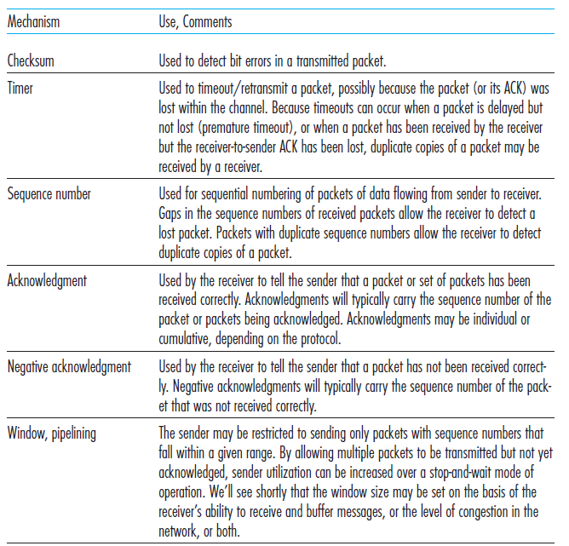
RDT Mechanism and their Use
3-<number>

Slide 55
Chapter 3 outline
3.1 transport-layer services
3.2 multiplexing and demultiplexing
3.3 connectionless transport: UDP
3.4 principles of reliable data transfer
3.5 connection-oriented transport: TCP
  segment structure
  reliable data transfer
  flow control
  connection management
3.6 principles of congestion control
3.7 TCP congestion control
Transport Layer
3-<number>

Slide 56
TCP: Overview RFCs: 793,1122,1323, 2018, 2581
point-to-point:
  one sender, one receiver
reliable, in-order byte steam
pipelined:
  TCP congestion and flow control set window size
full duplex data:
  bi-directional data flow in same connection
  MSS: maximum segment size
connection-oriented:
  Handshaking initiates sender, receiver state before data exchange
flow controlled:
  sender will not overwhelm receiver
Transport Layer
3-<number>

Slide 57
TCP segment structure
32 bits
URG: urgent data
(generally not used)
counting
by bytes
of data
(not segments!)
source port #
dest port #
sequence number
ACK: ACK #
valid
acknowledgement number
head
len
not
used
U
receive window
A
PSH: push data now
(generally not used)
P
R
S
F
# bytes
rcvr willing
to accept
checksum
Urg data pointer
RST, SYN, FIN:
connection estab
(setup, teardown
commands)
options (variable length)
application
data
(variable length)
Internet
checksum
(as in UDP)
Transport Layer
3-<number>

Slide 58
TCP seq. numbers, ACKs
outgoing segment from sender
sequence numbers:
  byte stream “number” of first byte in segment’s data
acknowledgements:
  seq # of next byte expected from other side
  cumulative ACK
  ACKs are piggybacked
Q: how receiver handles out-of-order segments
  A: TCP spec doesn’t say, - up to implementor
source port #
dest port #
sequence number
acknowledgement number
rwnd
checksum
urg pointer
window size
N
  sender sequence number space
sent
ACKed
sent, not-yet ACKed
(“in-flight”)
usable
but not
yet sent
not
usable
incoming segment to sender
source port #
dest port #
sequence number
acknowledgement number
A
rwnd
checksum
urg pointer
Transport Layer
3-<number>

Slide 59
TCP seq. numbers, ACKs
Host A
Host B
User
types
‘C’
Seq=42, ACK=79, data = ‘C’
host ACKs
receipt of
‘C’, echoes
back ‘C’
Seq=79, ACK=43, data = ‘C’
host ACKs
receipt
of echoed
‘C’
Seq=43, ACK=80
simple scenario
Transport Layer
3-<number>

Slide 60
TCP round trip time, timeout
Q: how to set TCP timeout value?
longer than RTT
  but RTT varies
too short: premature timeout, unnecessary retransmissions
too long: slow reaction to segment loss
Q: how to estimate RTT?
SampleRTT: measured time from segment transmission until ACK receipt
  ignore retransmissions
EstimatedRTT:
  Estimate RTT from average of previous measurements
Transport Layer
3-<number>

Slide 61
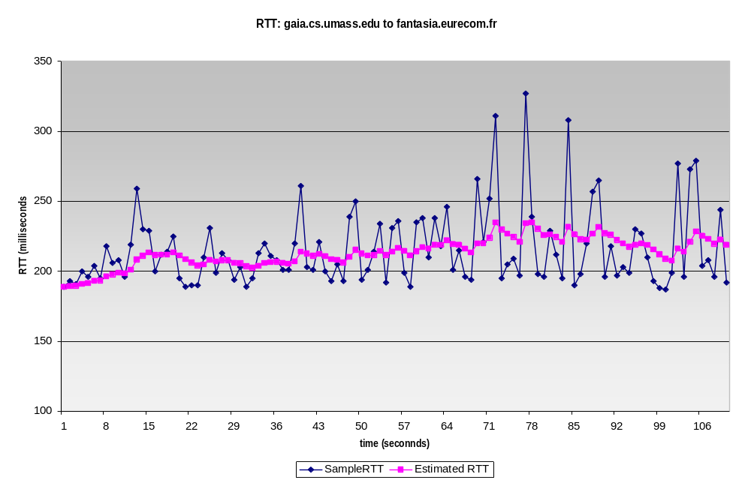
TCP round trip time, timeout
First Time : EstimatedRTT = SampleRTT
Next all measurements:
EstimatedRTT = (1- α)*EstimatedRTT + α*SampleRTT
typical value: α = 0.125
RTT: gaia.cs.umass.edu to fantasia.eurecom.fr
RTT (milliseconds)
sampleRTT
EstimatedRTT
time (seconds)
Transport Layer
3-<number>

Slide 62

TCP round trip time, timeout
Timeout interval: EstimatedRTT plus “safety margin”
estimate SampleRTT deviation from EstimatedRTT:
First Time: DevRTT = SampleRTT/2
Next all measurements:
DevRTT = (1-β)* DevRTT +
β*|SampleRTT-EstimatedRTT|
(typically, β = 0.25)
TimeoutInterval = EstimatedRTT + 4*DevRTT
estimated RTT
“safety margin”
Transport Layer
3-<number>

Slide 63
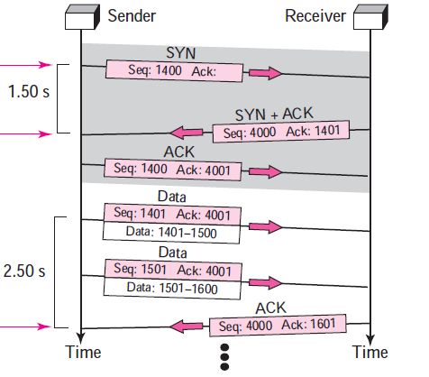
Example:
SRTT = 1.5
ERTT = 1.5
DRTT = (1.5) / 2 = 0.75
TimeOut = 1.5 + 4 × 0.75 = 4.5
SRTT = 2.5
ERTT = 7/8 ×1.5 + (1/8) × 2.5 = 1.625
DRTT = 3/4 (0.75) + (1/4) ×
|1.625 − 2.5| = 0.78
TimeOut = 1.625 + 4 × 0.78 = 4.74
Transport Layer
3-<number>

Slide 64
Chapter 3 outline
3.1 transport-layer services
3.2 multiplexing and demultiplexing
3.3 connectionless transport: UDP
3.4 principles of reliable data transfer
3.5 connection-oriented transport: TCP
  segment structure
  reliable data transfer
  flow control
  connection management
3.6 principles of congestion control
3.7 TCP congestion control
Transport Layer
3-<number>

Slide 65
TCP reliable data transfer
TCP creates rdt service on top of IP’s unreliable service
  pipelined segments
  cumulative acks
  single retransmission timer
retransmissions triggered by:
  timeout events
  duplicate acks
let’s initially consider simplified TCP sender:
  ignore duplicate acks
  ignore flow control, congestion control
Transport Layer
3-<number>

Slide 66
TCP sender events:
data rcvd from app:
create segment with seq #
seq # is byte-stream number of first data byte in segment
start timer if not already running
  think of timer as for oldest unacked segment
  expiration interval: TimeOutInterval
timeout:
retransmit segment that caused timeout
restart timer
ack rcvd:
if ack acknowledges previously unacked segments
  update what is known to be ACKed
  start timer if there are still unacked segments
Transport Layer
3-<number>

Slide 67
TCP sender (simplified)
data received from application above
create segment, seq. #: NextSeqNum
pass segment to IP (i.e., “send”)
NextSeqNum = NextSeqNum + length(data)
if (timer currently not running)
start timer
Λ
NextSeqNum = InitialSeqNum
SendBase = InitialSeqNum
wait
for
event
timeout
retransmit not-yet-acked segment with smallest seq. #
start timer
ACK received, with ACK field value y
if (y > SendBase) {
SendBase = y
/* SendBase–1: last cumulatively ACKed byte */
if (there are currently not-yet-acked segments)
start timer
else stop timer
}
Transport Layer
3-<number>

Slide 68
TCP: retransmission scenarios
Host A
Host B
Host A
Host B
SendBase=92
Seq=92, 8 bytes of data
Seq=92, 8 bytes of data
timeout
timeout
Seq=100, 20 bytes of data
ACK=100
X
ACK=100
ACK=120
Seq=92, 8 bytes of data
Seq=92, 8
bytes of data
SendBase=100
SendBase=120
ACK=100
ACK=120
SendBase=120
lost ACK scenario
premature timeout
Transport Layer
3-<number>

Slide 69
TCP: retransmission scenarios
Host A
Host B
Seq=92, 8 bytes of data
Seq=100, 20 bytes of data
timeout
ACK=100
X
ACK=120
Seq=120, 15 bytes of data
cumulative ACK
Transport Layer
3-<number>

Slide 70
TCP ACK generation [RFC 1122, RFC 2581]
event at receiver
arrival of in-order segment with
expected seq #. All data up to
expected seq # already ACKed
arrival of in-order segment with
expected seq #. One other
segment has ACK pending
arrival of out-of-order segment
higher-than-expect seq. # .
Gap detected
arrival of segment that
partially or completely fills gap
TCP receiver action
delayed ACK. Wait up to 500ms
for next segment. If no next segment,
send ACK
immediately send single cumulative
ACK, ACKing both in-order segments
immediately send duplicate ACK,
indicating seq. # of next expected byte
immediate send ACK, provided that
segment starts at lower end of gap
Transport Layer
3-<number>

Slide 71
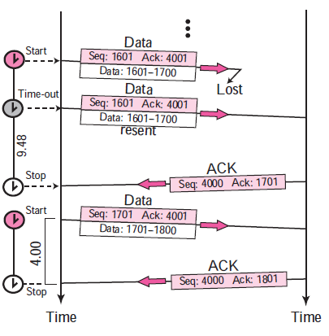
Doubling timeout interval for Retransmitted packet
For retransmitted segment double the next timer timeout time : Exponential backoff
SRTT = 2.50
ERTT = 1.625
DRTT = 0.78
TimeOut = 4.74
RTO = 2*4.74 = 9.48
Exponential Backoff of RTO
SRTT = 4.00
ERTT = 1.92
DRTT = 1.105
TimeOut = 6.34
Transport Layer
3-<number>

Slide 72
TCP fast retransmit
time-out period often relatively long:
  long delay before resending lost packet
detect lost segments via duplicate ACKs.
  sender often sends many segments back-to-back
  if segment is lost, there will likely be many duplicate ACKs.
TCP fast retransmit
if sender receives 3 ACKs for same data
(“triple duplicate ACKs”), resend unacked segment with smallest seq #
  likely that unacked segment lost, so don’t wait for timeout
(“triple duplicate ACKs”),
Transport Layer
3-<number>

Slide 73
TCP fast retransmit
Host A
Host B
Seq=92, 8 bytes of data
Seq=100, 20 bytes of data
X
ACK=100
timeout
ACK=100
ACK=100
ACK=100
Seq=100, 20 bytes of data
fast retransmit after sender
receipt of triple duplicate ACK
Transport Layer
3-<number>

Slide 74
GBN or Selective repeat??
Cumulative ACK
One Timer at sender side
Buffering out of order packets at receiver
Selective retransmission
Go Back N
Selective Repeat
Transport Layer
3-<number>

Slide 75
Chapter 3 outline
3.1 transport-layer services
3.2 multiplexing and demultiplexing
3.3 connectionless transport: UDP
3.4 principles of reliable data transfer
3.5 connection-oriented transport: TCP
  segment structure
  reliable data transfer
  flow control
  connection management
3.6 principles of congestion control
3.7 TCP congestion control
Transport Layer
3-<number>

Slide 76
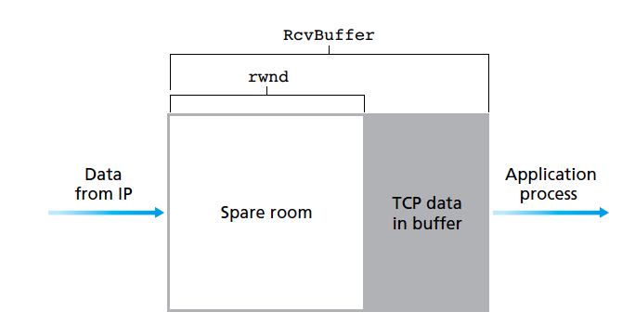
TCP flow control
Flow control is a speed-matching service—matching the rate at which the sender is sending against the rate at which the receiving application is reading.
sender maintains a variable called the receive window (rwnd).
It gives the sender an idea of how much free buffer space is available at the receiver
3-<number>

Slide 77
TCP flow control
Receiver side variables:
LastByteRead: the number of last byte read from the buffer by the application process.
LastByteRcvd: the number of the last byte arrived and has been placed in the receive buffer.
To prevent overflow :
LastByteRcvd – LastByteRead <= RcvBuffer
The receive window, denoted rwnd is set to the amount of spare room in the buffer:
rwnd = RcvBuffer – [LastByteRcvd – LastByteRead]
Transport Layer
3-<number>

Slide 78
TCP flow control
Sender side variables:
LastByteSent
LastByteAcked
LastByteSent – LastByteAcked, is the amount of unacknowledged data that A has sent into the connection.
To prevent the overflow at receiver:
LastByteSent – LastByteAcked <= rwnd
If rwnd is set to 0 by receiver then sender will keep sending one byte packet to receiver to know whether rwnd is set to new value or not
Transport Layer
3-<number>

Slide 79
Chapter 3 outline
3.1 transport-layer services
3.2 multiplexing and demultiplexing
3.3 connectionless transport: UDP
3.4 principles of reliable data transfer
3.5 connection-oriented transport: TCP
  segment structure
  reliable data transfer
  flow control
  connection management
3.6 principles of congestion control
3.7 TCP congestion control
Transport Layer
3-<number>

Slide 80
TCP 3-way handshake
client state
server state
LISTEN
LISTEN
choose init seq num, x
send TCP SYN msg
SYNSENT
SYNbit=1, Seq=x
choose init seq num, y
send TCP SYNACK
msg, acking SYN
SYN RCVD
SYNbit=1, Seq=y
ACKbit=1; ACKnum=x+1
received SYNACK(x)
indicates server is live;
send ACK for SYNACK;
this segment may contain
client-to-server data
ESTAB
ACKbit=1, ACKnum=y+1
received ACK(y)
indicates client is live
ESTAB
Transport Layer
3-<number>

Slide 81
TCP: closing a connection
client, server each close their side of connection
  send TCP segment with FIN bit = 1
respond to received FIN with ACK
  on receiving FIN, ACK can be combined with own FIN
simultaneous FIN exchanges can be handled
Transport Layer
3-<number>

Slide 82
TCP: closing a connection
client state
server state
ESTAB
ESTAB
clientSocket.close()
FIN_WAIT_1
can no longer
send but can
receive data
FINbit=1, seq=x
CLOSE_WAIT
ACKbit=1; ACKnum=x+1
can still
send data
FIN_WAIT_2
wait for server
close
LAST_ACK
FINbit=1, seq=y
TIMED_WAIT
can no longer
send data
ACKbit=1; ACKnum=y+1
timed wait
for 2*max
segment lifetime
CLOSED
CLOSED
Transport Layer
3-<number>

Slide 83
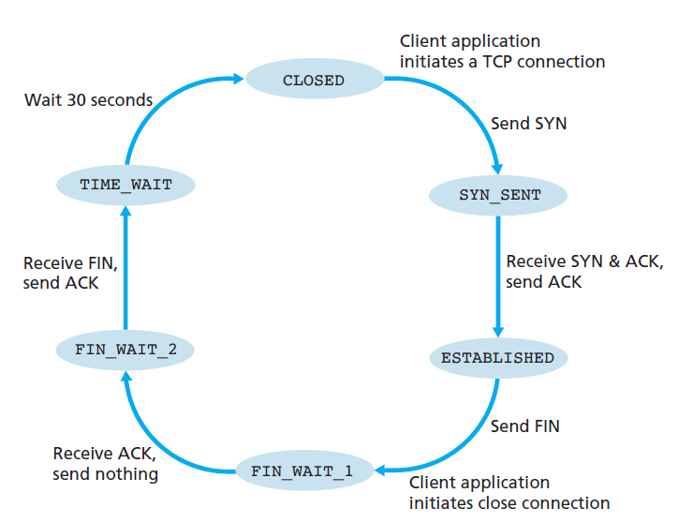
TCP 3-way handshake FSM : Client
Transport Layer
3-<number>

Slide 84
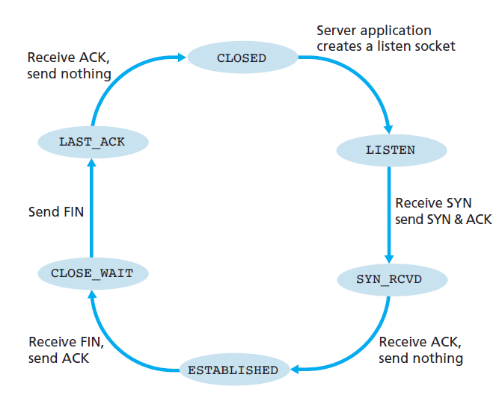
TCP 3-way handshake FSM : Server
Transport Layer
3-<number>

Slide 85
Chapter 3 outline
3.1 transport-layer services
3.2 multiplexing and demultiplexing
3.3 connectionless transport: UDP
3.4 principles of reliable data transfer
3.5 connection-oriented transport: TCP
  segment structure
  reliable data transfer
  flow control
  connection management
3.6 principles of congestion control
3.7 TCP congestion control
Transport Layer
3-<number>

Slide 86
Principles of congestion control
congestion:
informally: “too many sources sending too much data too fast for network to handle”
different from flow control!
Cost of congestion:
  lost packets (buffer overflow at routers)
  long delays (queueing in router buffers)
  Retransmissions
Transport Layer
3-<number>

Slide 87
Approaches towards congestion control
two broad approaches towards congestion control:
end-end congestion control:
no explicit feedback from network
congestion inferred from end-system observed loss, delay
approach taken by TCP
network-assisted congestion control:
routers provide feedback to end systems
  single bit indicating congestion.
  Choke packets
Transport Layer
3-<number>

Slide 88
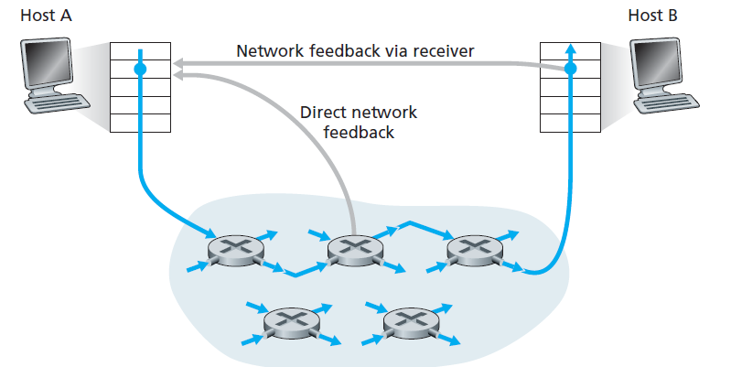
Approaches towards congestion control
Transport Layer
3-<number>

Slide 89
Case study: ATM ABR congestion control
ABR: available bit rate:
elastic service
if sender’s path underloaded:
  sender should use available bandwidth
if sender’s path congested:
  sender throttled to minimum guaranteed rate.
RM (resource management) cells:
sent by sender, with data cells
bits in RM cell set by switches (“network-assisted”)
  NI bit: no increase in rate (mild congestion)
  CI bit: severe congestion indication
RM cells returned to sender by receiver, with bits intact
Transport Layer
3-<number>

Slide 90
Case study: ATM ABR congestion control
RM cell
data cell
two-byte ER (explicit rate) field in RM cell
  congested switch may lower ER value in cell
EFCI bit in data cells: set to 1 in congested switch
  Explicit Forward Congestion Indication
  if data cell preceding RM cell has EFCI set, receiver sets CI bit in returned RM cell
Transport Layer
3-<number>

Slide 91
Chapter 3 outline
3.1 transport-layer services
3.2 multiplexing and demultiplexing
3.3 connectionless transport: UDP
3.4 principles of reliable data transfer
3.5 connection-oriented transport: TCP
  segment structure
  reliable data transfer
  flow control
  connection management
3.6 principles of congestion control
3.7 TCP congestion control
Transport Layer
3-<number>

Slide 92
TCP Congestion Control: details
sender sequence number space
TCP sending rate:
roughly: send cwnd bytes, wait RTT for ACKS, then send more bytes
cwnd
last byte
ACKed
last byte sent
sent, not-yet ACKed
(“in-flight”)
rate
cwnd
It introduces new variable at sender side : cwnd
sender limits transmission:
~
bytes/sec
~
RTT
LastByteSent-
LastByteAcked
Min{rwnd,cwnd}
<
Transport Layer
3-<number>

Slide 93
TCP Slow Start
Host A
Host B
when connection begins, increase rate exponentially until first loss event:
  initially cwnd = 1 MSS
  double cwnd every RTT
  done by incrementing cwnd for every ACK received
summary: initial rate is slow but ramps up exponentially fast
one segment
RTT
two segments
four segments
time
Transport Layer
3-<number>

Slide 94
TCP Congestion Avoidance : additive increase
approach: sender increases transmission rate (window size) until loss occurs
  additive increase: increase cwnd by 1 MSS every RTT until loss detected
  multiplicative decrease: cut cwnd in half after loss
additively increase window size …
…. until loss occurs (then cut window in half)
cwnd: TCP sender
congestion window size
time
Transport Layer
3-<number>

Slide 95
TCP: Fast recovery
Loss indicated by timeout ( TCP Tahoe):
  cwnd set to 1 MSS;
  window then grows exponentially (as in slow start) to threshold, then grows linearly
loss indicated by 3 duplicate ACKs: TCP RENO
  cwnd is cut in half of threshold then grows linearly
Transport Layer
3-<number>

Slide 96

TCP: switching from slow start to CA
variable ssthresh is maintained for Threshold value
on loss event, ssthresh is set to 1/2 of cwnd just before loss event
Transport Layer
3-<number>

Slide 97


Summary: TCP Congestion Control
New
ACK!
New
ACK!
.
duplicate ACK
new ACK
dupACKcount++
new ACK
cwnd = cwnd + MSS (MSS/cwnd)
dupACKcount = 0
transmit new segment(s), as allowed
cwnd = cwnd+MSS
dupACKcount = 0
transmit new segment(s), as allowed
Λ
cwnd = 1 MSS
ssthresh = 64 KB
dupACKcount = 0
cwnd > ssthresh
slow
start
Λ
congestion
avoidance
timeout
ssthresh = cwnd/2
cwnd = 1 MSS
dupACKcount = 0
retransmit missing segment
duplicate ACK
timeout
dupACKcount++
ssthresh = cwnd/2
cwnd = 1 MSS
dupACKcount = 0
retransmit missing segment
timeout
New
ACK!
ssthresh = cwnd/2
cwnd = 1
dupACKcount = 0
retransmit missing segment
New ACK
dupACKcount == 3
cwnd = ssthresh
dupACKcount = 0
dupACKcount == 3
ssthresh= cwnd/2
cwnd = ssthresh + 3
retransmit missing segment
ssthresh= cwnd/2
cwnd = ssthresh + 3
retransmit missing segment
fast
recovery
duplicate ACK
cwnd = cwnd + MSS
transmit new segment(s), as allowed
Transport Layer
3-<number>

Slide 98
rdt2.1: sender, handles garbled ACK/NAKs
rdt_send(data)
sndpkt = make_pkt(0, data, checksum)
udt_send(sndpkt)
rdt_rcv(rcvpkt) &&
( corrupt(rcvpkt) ||
isNAK(rcvpkt) )
Wait for call 0 from above
Wait for ACK or NAK 0
udt_send(sndpkt)
rdt_rcv(rcvpkt)
&& notcorrupt(rcvpkt)
&& isACK(rcvpkt)
rdt_rcv(rcvpkt)
&& notcorrupt(rcvpkt)
&& isACK(rcvpkt)
Λ
Λ
Wait for ACK or NAK 1
Wait for
call 1 from above
rdt_rcv(rcvpkt) &&
( corrupt(rcvpkt) ||
isNAK(rcvpkt) )
rdt_send(data)
udt_send(sndpkt)
sndpkt = make_pkt(1, data, checksum)
udt_send(sndpkt)
Transport Layer
3-<number>

Slide 99
rdt2.1: receiver, handles garbled ACK/NAKs
rdt_rcv(rcvpkt) && notcorrupt(rcvpkt)
&& has_seq0(rcvpkt)
extract(rcvpkt,data)
deliver_data(data)
sndpkt = make_pkt(ACK, chksum)
udt_send(sndpkt)
rdt_rcv(rcvpkt) && (corrupt(rcvpkt)
rdt_rcv(rcvpkt) && (corrupt(rcvpkt)
sndpkt = make_pkt(NAK, chksum)
udt_send(sndpkt)
sndpkt = make_pkt(NAK, chksum)
udt_send(sndpkt)
Wait for
0 from below
Wait for
1 from below
rdt_rcv(rcvpkt) &&
not corrupt(rcvpkt) &&
has_seq1(rcvpkt)
rdt_rcv(rcvpkt) &&
not corrupt(rcvpkt) &&
has_seq0(rcvpkt)
sndpkt = make_pkt(ACK, chksum)
udt_send(sndpkt)
sndpkt = make_pkt(ACK, chksum)
udt_send(sndpkt)
rdt_rcv(rcvpkt) && notcorrupt(rcvpkt)
&& has_seq1(rcvpkt)
extract(rcvpkt,data)
deliver_data(data)
sndpkt = make_pkt(ACK, chksum)
udt_send(sndpkt)
Transport Layer
3-<number>

